Slide 1
2020-21 NFHS VOLLEYBALL RULES POWERPOINT
Rules Changes
Major Editorial Changes
Points of Emphasis

Slide 2
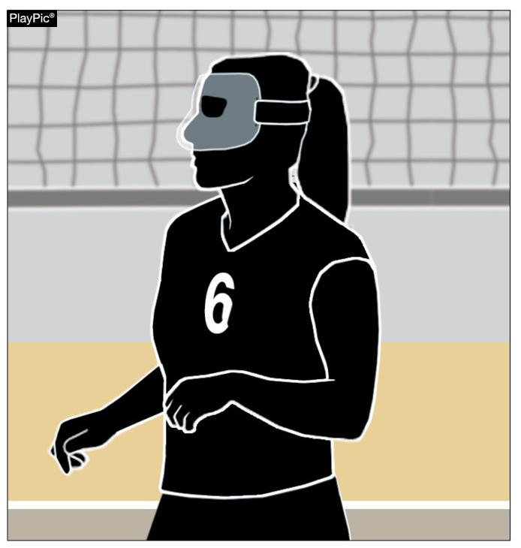
PROTECTIVE FACE MASK 4-1-4 (NEW)
Players may protect facial injuries by wearing a protective face mask.
The mask must be made of a hard material free of protrusions and molded to the face.
Notes:
Players may protect facial injuries by wearing a protective face mask.
The mask must be made of a hard material free of protrusions and molded to the face.
Rationale: Creates consistency with other NFHS rules codes and contributes to minimizing the risk of injury.

Slide 3
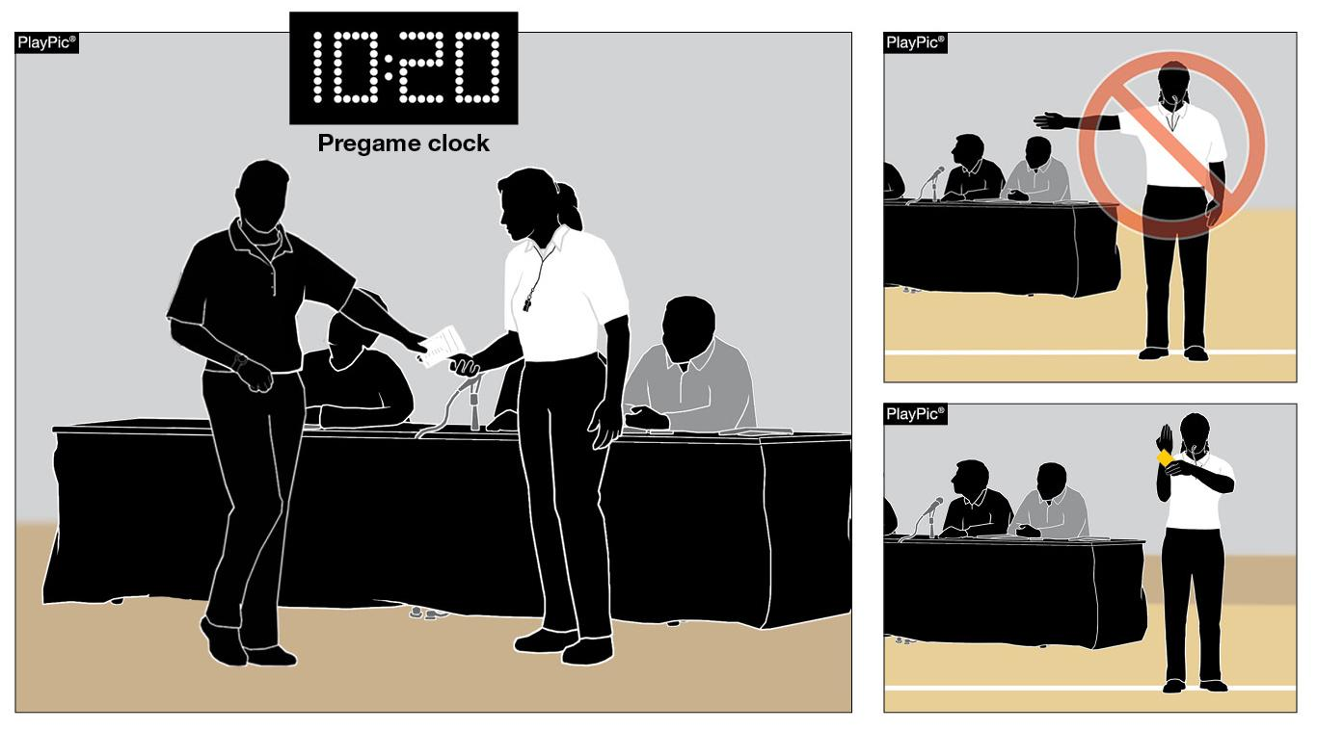
ROSTER SUBMISSIONS 7-1-1; 7-1-1 PENALTIES; 7-1-1 PENALTIES 2 (NEW); 9-9-1a (NEW); 10-3-7b
The penalty is no longer a loss of rally/point.
It is now an unnecessary delay (administrative yellow card) assessed at the start of the set.
When a team roster is not ready for submission during the prematch conference, but is provided before 10 minutes remain on the clock…
Notes:
When a team roster is not ready for submission during the prematch conference, but is provided before 10 minutes remain on the clock…
The penalty is no longer a loss of rally/point.
It is now an unnecessary delay (administrative yellow card) assessed at the start of the set.
Rationale: Creates an appropriate penalty progression for a late roster. Any corrections made to the roster after 10 minutes remain on the pregame clock still results in a loss of rally/point awarded to the opponent when the inaccuracy is discovered.
Note: Old 10-3-7b was deleted

Slide 4
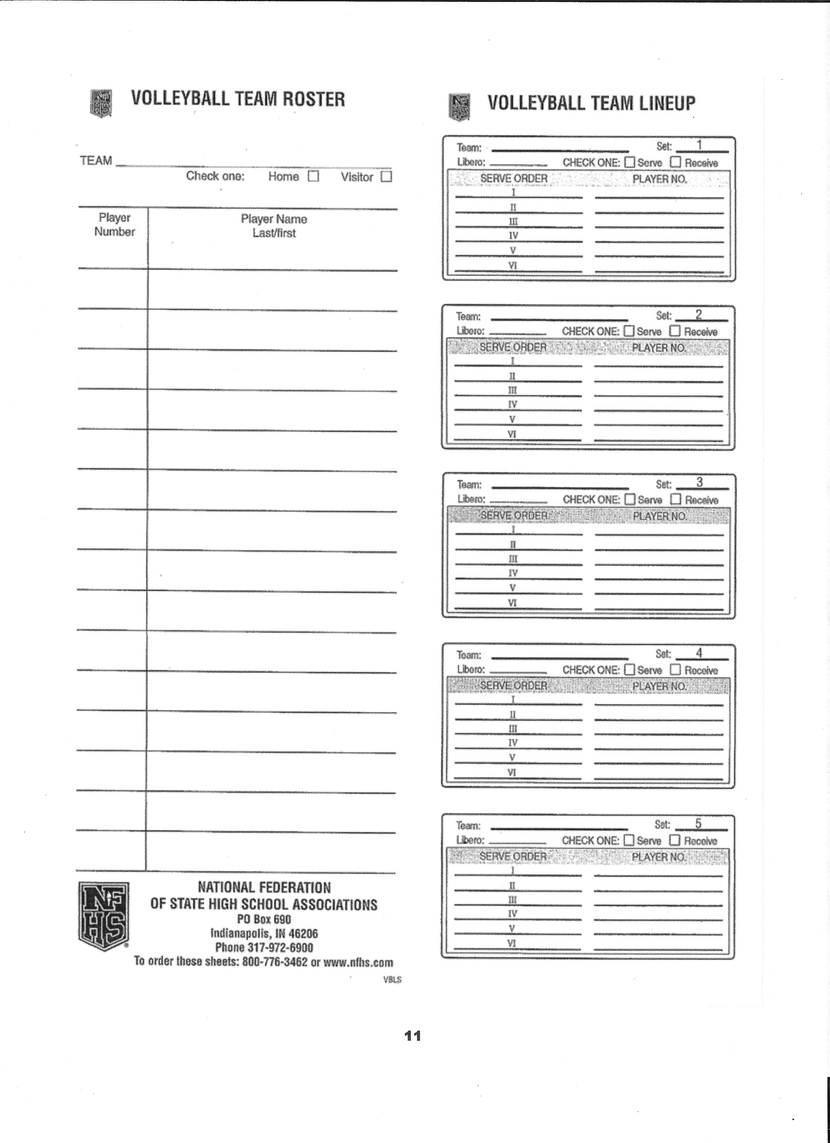
ROSTER/LINEUP SHEET SUBMISSIONS FOR THIS FALL
THE R/L SHEET CAN BE SUBMITTED DIRECTLY TO THE SCORE TABLE INSTEAD OF THE R2 AT THE PREMATCH CONFERENCE TO LIMIT HAND CONTACTS.
Notes:
When a team roster is not ready for submission during the prematch conference, but is provided before 10 minutes remain on the clock…
The penalty is no longer a loss of rally/point.
It is now an unnecessary delay (administrative yellow card) assessed at the start of the set.
Rationale: Creates an appropriate penalty progression for a late roster. Any corrections made to the roster after 10 minutes remain on the pregame clock still results in a loss of rally/point awarded to the opponent when the inaccuracy is discovered.
Note: Old 10-3-7b was deleted

Slide 5
CORRECTING A SUBMITTED LINEUP 7-1-4a(1) & 7-1-4a(2) NEW
If a clerical error is made on the lineup by listing a libero number that no team member is wearing, the error shall be corrected without penalty.
Notes:
If a clerical error is made on the lineup by listing a libero number that no team member is wearing, the error shall be corrected without penalty.
Rationale: Creates consistency in allowing the correction of a clerical error (listing a number that no team member is wearing) on the lineup for a starting position and the libero position.

Slide 6
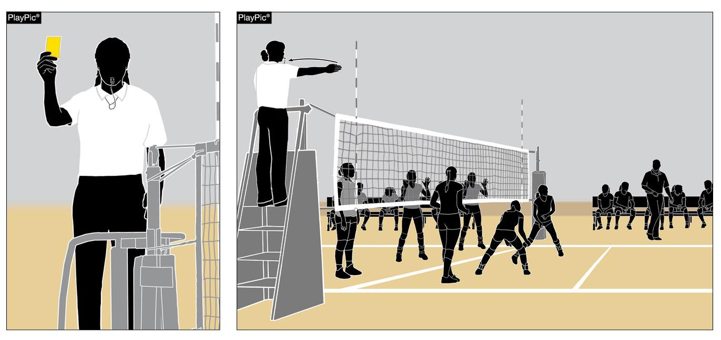
UNSPORTING YELLOW CARD PENALTY 12-2-6
When a yellow card is issued for unsporting conduct to the head coach, assistant coach(es) or team bench the head coach will no longer be required to remain seated.
If a red unsporting conduct card is issued to the head coach, assistant coach(es) or team bench, the head coach will be required to remain seated for the duration of the match.
Notes:
When a yellow card is issued for unsporting conduct to the head coach, assistant coach(es) or team bench the head coach will no longer be required to remain seated.
If a red unsporting conduct card is issued to the head coach, assistant coach(es) or team bench, the head coach will be required to remain seated for the duration of the match.
Rationale: Creates a penalty progression by allowing an official to warn a head coach with a yellow unsporting conduct card without requiring the coach to remain seated for the remainder of the match.

Slide 7
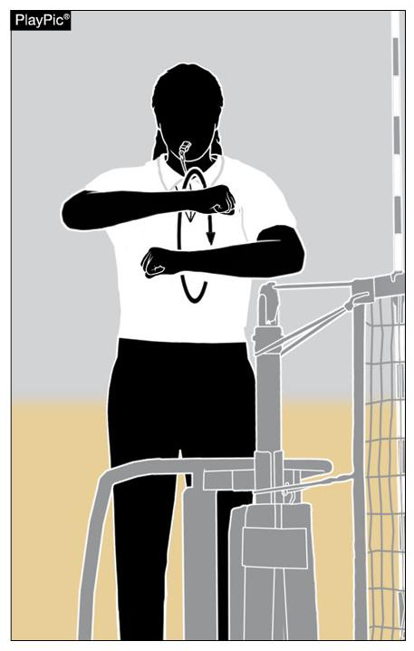
NEW SUBSTITUTION SIGNAL FOR REFEREE SIGNAL #15
When a team requests a substitution, the official will administer two short whistles.
The official will rotate his/her forearms around each other with closed hands at shoulder height two times to signal the substitution.
It’s requested that coaches perform this signal as the motion helps get our attention quicker. (Same goes for Time-outs. ~ Thank-you!)
Notes:
When a team requests a substitution, the official will administer two short whistles.
The official will rotate his/her forearms around each other with closed hands at shoulder height two times to signal the substitution.
Rationale: Aligns substitution mechanics with the current trends of the sport.

Slide 8
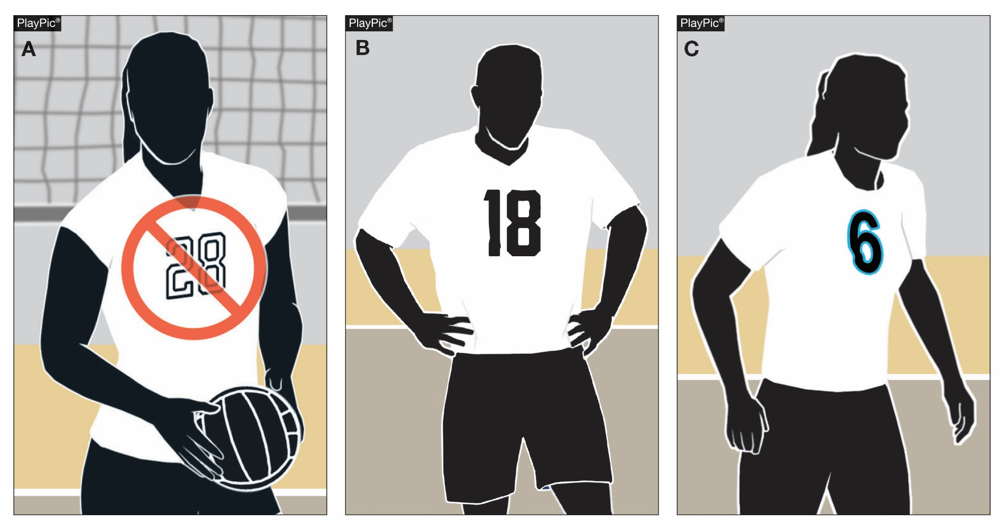
RULES REMINDER: LEGAL UNIFORM 4-2-4c
Illegal (2023)
Legal
Legal
Beginning with the 2023 season, the body of the uniform number must clearly contrast from the body of the uniform regardless of trim.
CT has been enforcing this for a while now via your state R.I.
Notes:
Rules Reminder
This is a reminder that beginning with the 2023 season, the body of the uniform number must clearly contrast from the body of the uniform regardless of trim.
This will eliminate the allowance of trim to provide the only contrast between the body of the number and the uniform top. Trim will still be allowed (a contrasting border not to exceed ½ inch in width at its widest point).
All currently compliant uniform numbers will be compliant through the 2022-23 school year.
Rationale: Allows officials and scorers to easily identify uniform numbers.

Slide 9
2020-21 NFHS VOLLEYBALL
Editorial Changes

Slide 10
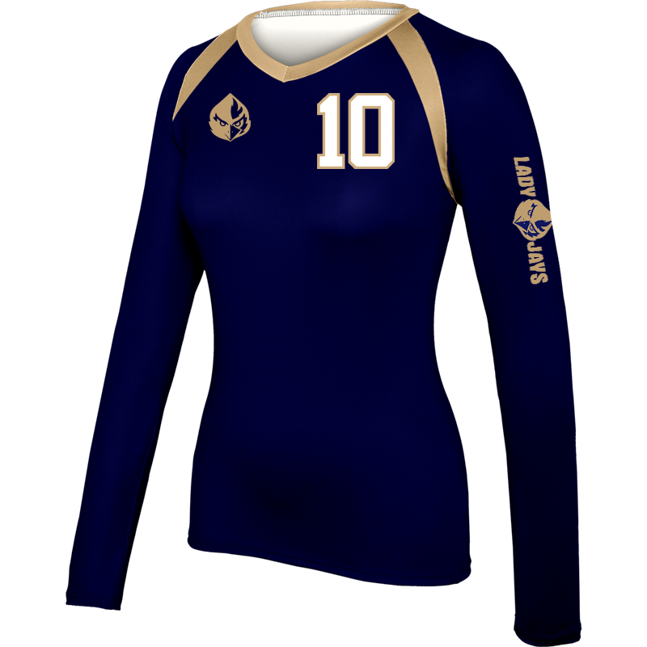
UNIFORMS 4-2-1e
Language referencing the size restrictions of mascots and/or school names placed on the uniform sleeve as part of the uniform requirements was removed.
School references are
permitted on the sleeve(s)
of the uniform top
without size restrictions.
Compliant
Notes:
Language referencing the size restrictions of mascots and/or school names placed on the uniform sleeve as part of the uniform requirements was removed.
School references are permitted on the sleeve(s) of the uniform top without size restrictions.

Slide 11
EXCEPTIONAL SUBSTITUTION 10-3-6b, 10-3-6c, 10-3-6 NOTE (NEW)
Reorganizes and clarifies the order of priority for an exceptional substitution for an injured/ill player aligning the language with Rule 10-4-3b.
Order of Priority:
By a teammate who has never played in the set or a player who has played in that position earlier in the set;
By any legal teammate on the bench (excluding the libero or libero replacement), regardless of previous position played;
By a libero if no other possible substitute exists.
When no longer playing as a libero, that player must wear the same uniform as his/her teammates.
The team will continue to play with no libero.
Notes:
Reorganizes and clarifies the order of priority for an exceptional substitution for an injured/ill player aligning the language with Rule 10-4-3b.
Order of Priority:
By a teammate who has never played in the set or a player who has played in that position earlier in the set;
By any legal teammate on the bench (excluding the libero or libero replacement), regardless of previous position played;
By a libero if no other possible substitute exists.
When no longer playing as a libero, that player must wear the same uniform as his/her teammates.
The team will continue to play with no libero.

Slide 12
EDITORIAL CHANGES
5-4-3c(22) – Whistle and signal “end-of-set,” whistle and direct…
5-4-4b, c – Deleted repetitive information and combined items b. and c.
New b. Following non deciding sets, after the first referee has confirmed the score of the set, he/she whistles and signals the teams to change courts. The team members proceed immediately to their new team benches. The players proceed counter clockwise along the sideline outside the standards, then directly to their new team benches. The timer begins timing the three-minute interval between sets with the first referee’s second whistle directing teams to their team benches.
Re-letter remaining articles
Notes:
5-4-3c(22) – Added “whistle and” to more accurately describe the mechanics of the first referee while administering “end-of-set.”
5-4-4b,c – Deleted repetitive information and combined items b. and c. Re-lettered remaining articles.

Slide 13
EDITORIAL CHANGES
5-5-3b(20) – …(five minutes when intermission is used)
7-1-2 – New formatting to align with 7-1-1 Roster:
ART. 2 . . . Lineup:
a. No later than…
b. Thereafter, the written lineup…
9-7 PENALTIES 3 – For a multiple fault, only one penalty is assessed (loss of rally/point or a charged time-out).
9-9-1m – A libero or libero replacement…
Notes:
5-5-3b(20) – Added “if used” to correct an editorial error.
7-1-2 – New formatting to align with 7-1-1 Roster.
9-7 PENALTIES 3 – Deleted “or a charged time-out” as the language is no longer relevant.
9-9-1m – Added “libero replacement” to more accurately reflect this unnecessary delay.

Slide 14
EDITORIAL CHANGES
12-2 Procedure for Unsporting Conduct Violations 1a, 2 (pgs. 50-51) –
1a. Whistle and hold the card(s) in the hand(s)…
2. …It is the responsibility of the first referee to immediately…whistle and administer any card(s)…
Card Procedures for Unsporting Conduct Violations (pg. 68) –
First referee whistles and holds card in hand…
First referee whistles and holds a card (head high)…
Unnecessary Delay Chart (NEW) (pg. 69) – New Chart illustrating the delay penalty progression.
Notes:
12-2 Procedure for Unsporting Conduct Violations 1a, 2 – Added “Whistle and” to more accurately describe the procedure for unsporting conduct violations.
Card Procedures for Unsporting Conduct Violations – Again added “whistle and” to more accurately describe the procedure for unsporting conduct violations.
Unnecessary Delay Chart – Added a new Unnecessary Delay Chart to illustrate the delay penalty progression.

Slide 15
2020-21 NFHS VOLLEYBALL
Points of Emphasis

Slide 16
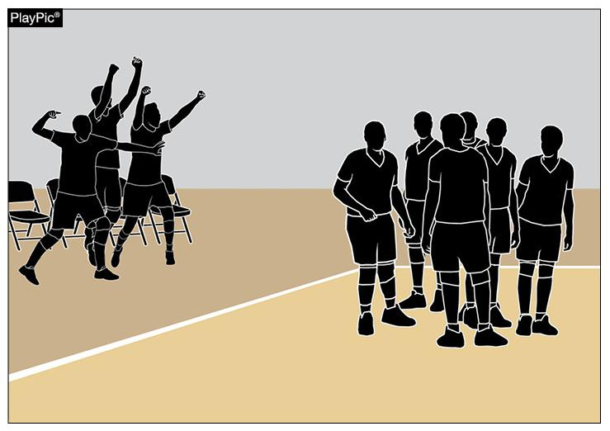
BENCH BEHAVIOR/SPORTSMANSHIP
Rule 12-2-7a allows bench personnel to, “Spontaneously react to an outstanding play by members of their own team.”
Team celebrations must be done in an appropriate, sporting manner.
The location and duration of these celebrations should not impede with the normal flow of the match.
Notes:
Rule 12-2-7a allows bench personnel to, “Spontaneously react to an outstanding play by members of their own team.”
Team celebrations must be done in an appropriate, sporting manner.
The location and duration of these celebrations should not impede with the normal flow of the match.

Slide 17
BENCH BEHAVIOR/SPORTSMANSHIP
Celebrations that continue after teams are ready for play and/or move outside of the bench area may be deemed excessive.
Excessive and disruptive reactions may result in an unsporting conduct penalty as described in Rule 12-2 PENALTIES.
Notes:
Celebrations that continue after teams are ready for play and/or move outside of the bench area may be deemed excessive.
Excessive and disruptive reactions may result in an unsporting conduct penalty as described in Rule 12-2 PENALTIES.

Slide 18
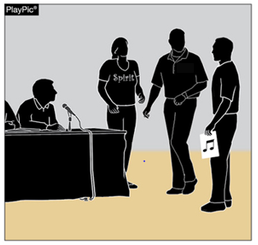
MANAGEMENT OF NON-TEAM PERSONNEL
It is the responsibility of coaches to educate school administration and the school community as to the sportsmanship nuances of the game of volleyball. This should include:
Appropriate times cheerleaders may or may not cheer and proper location to cheer,
Appropriate comments, timing of announcements and good sportsmanship by PA announcers;
Appropriate time for music and sound effects (1-8);
Appropriate location and behavior of fans and mascots, etc.
Notes:
It is the responsibility of coaches to educate school administration and the school community as to the sportsmanship nuances of the game of volleyball. This should include:
Appropriate times cheerleaders may or may not cheer and proper location to cheer,
Appropriate comments, timing of announcements and good sportsmanship by PA announcers;
Appropriate time for music and sound effects (1-8);
Appropriate location and behavior of fans and mascots, etc.

Slide 19
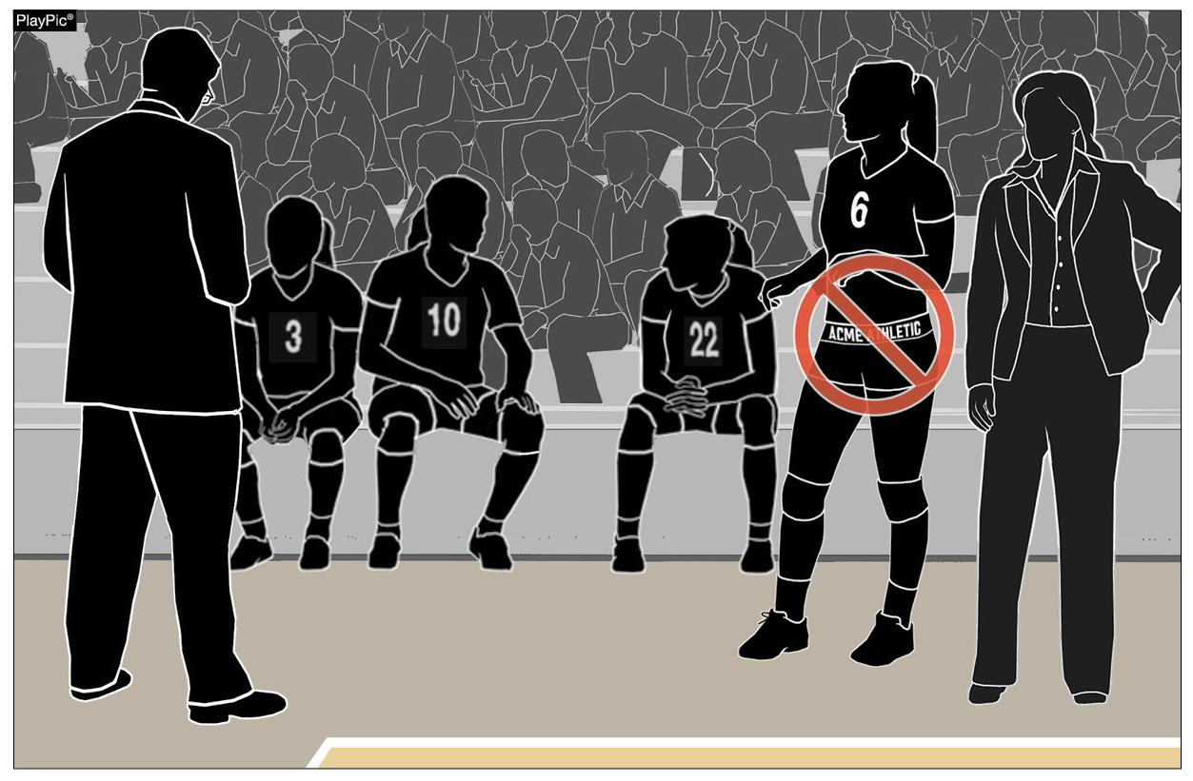
UNIFORM BOTTOM COMPLIANCE
It is the responsibility of the head coach to ensure that his/her players are properly equipped, which includes items purchased by the individual athlete.
Manufacturers are producing spandex marketed for volleyball with multiple large logos along the waistband. These bottoms, worn with uniform tops tucked or untucked, violate rule 4-2-1f.
Officials should enforce these uniform violations when they occur with the appropriate penalty (4-2 PENALTIES).
Notes:
It is the responsibility of the head coach to ensure that his/her players are properly equipped, which includes items purchased by the individual athlete.
Manufacturers are producing spandex marketed for volleyball with multiple large logos along the waistband. These bottoms, worn with uniform tops tucked or untucked, violate rule 4-2-1f.
Officials should enforce these uniform violations when they occur with the appropriate penalty (4-2 PENALTIES).

Slide 20
NEW UNIFORM REMINDER:
When ordering new uniforms, best to submit a pre-purchase design to your state rules interpreter.
This will prevent potentially illegal uniforms from being purchased and found in-season. Legal uniforms are required for CIAC contests and more importantly the post-season tournament.
Notes:
It is the responsibility of the head coach to ensure that his/her players are properly equipped, which includes items purchased by the individual athlete.
Manufacturers are producing spandex marketed for volleyball with multiple large logos along the waistband. These bottoms, worn with uniform tops tucked or untucked, violate rule 4-2-1f.
Officials should enforce these uniform violations when they occur with the appropriate penalty (4-2 PENALTIES).

Slide 21
COACHES CONSIDER THIS:
SENIOR DAY/NIGHT
HAVE IT AT THE FIRST HOME CONTEST THIS SEASON
HONORING YOUR SENIORS EARLY AVOIDS THE UNCERTAINTY OF THE SEASON.
BEST OF LUCK TO YOU!
Notes:
It is the responsibility of the head coach to ensure that his/her players are properly equipped, which includes items purchased by the individual athlete.
Manufacturers are producing spandex marketed for volleyball with multiple large logos along the waistband. These bottoms, worn with uniform tops tucked or untucked, violate rule 4-2-1f.
Officials should enforce these uniform violations when they occur with the appropriate penalty (4-2 PENALTIES).

Slide 22
NFHS OFFICIALS ASSOCIATION

Slide 23
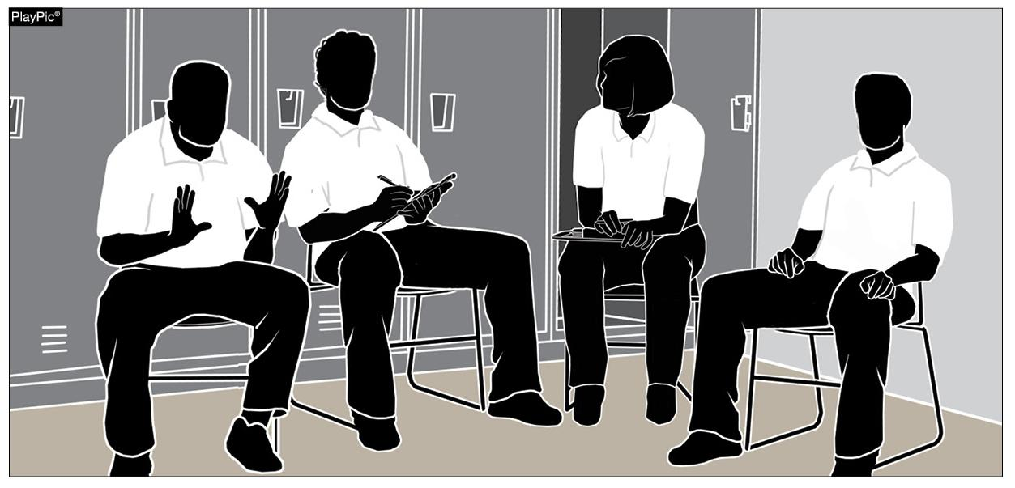
OFFICIALS’ COMMUNICATION
* No officials’ changing or meeting rooms 2020-21
The first and second referees along with both line judges should participate in a pre-match conference to discuss the responsibilities of each crew member.
Crew members should be prepared to ask questions and the first referee prepared to answer them.
Topics of discussion should include:
Clarifying the responsibilities and mechanics during penalty administration; and
The review of informal signals.
Notes:
The first and second referees along with both line judges should participate in a pre-match conference to discuss the responsibilities of each crew member.
Crew members should be prepared to ask questions and the first referee prepared to answer them.
Topics of discussion should include:
Clarifying the responsibilities and mechanics during penalty administration; and
The review of informal signals.

Slide 24
NFHS LEARNING CENTER

Slide 25
NFHS NETWORK

Slide 26
THANK YOU
National Federation of State High School Associations PO Box 690 | Indianapolis, IN 46206 Phone: 317-972-6900 | Fax: 317.822.5700 www.nfhs.org | www.nfhslearn.com | www.nfhsnetwork.com

